Slide 1
PRESENT SIMPLE
USE

Slide 2
USE 1:
The simple present says that something was true in the past, is true in the present, and will be true in the future.
It expresses general statements of fact and timeless truths.

Slide 3

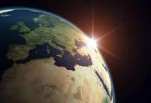
EXAMPLES:
The earth goes round the sun.
The world is round.

Slide 4

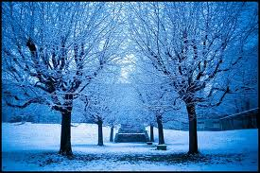
EXAMPLES:
It rains more in winter.
It usually snows in January.

Slide 5
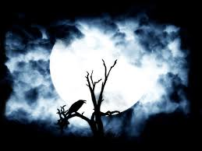

EXAMPLES:
Birds don’t sing at night.

Slide 6
USE 2:
The simple present is used to express habitual or everyday activities(Daily routine).
Examples:
I get up at seven every morning.
Her parents go to Paris every summer.
**** more examples:

Slide 7


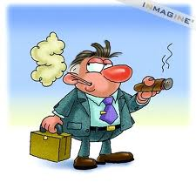
EXAMPLES:
She bites her nails.
He plays tennis on Monday nights.
He smokes cigars.

Slide 8

Use 3:
We use the simple present for permanent situations.
Example:
My parents live near Dover.
Jack doesn’t work on Saturday.

Slide 9
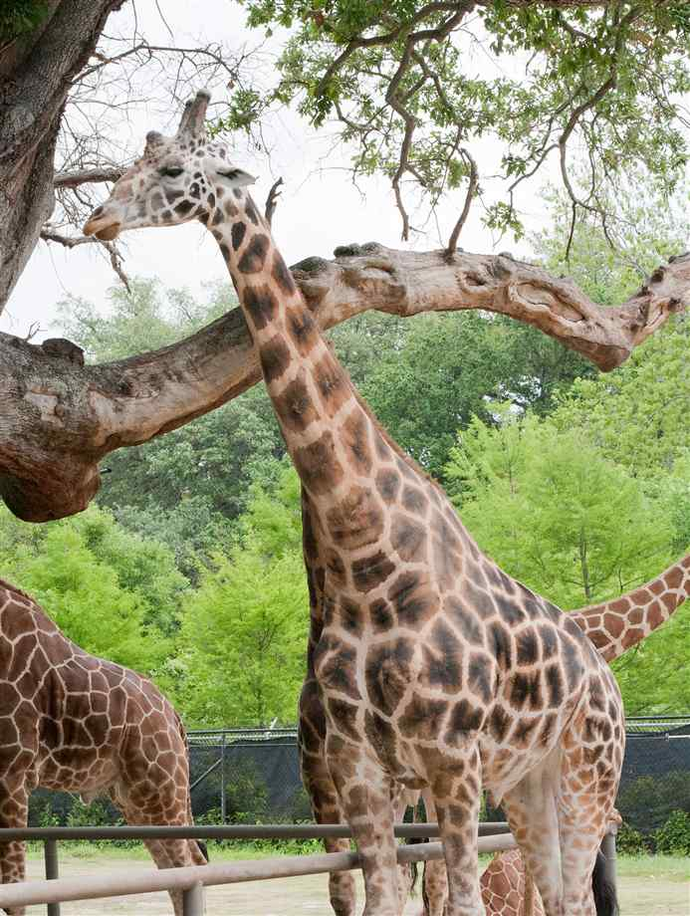
EXAMPLES:
Giraffes live in Africa. They feed on acacia leaves.

Slide 10


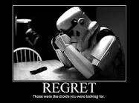

USE 4:
When we perform an action by speaking, for example when we promise to do something, we usually use the simple present. (sometimes called performative verbs)
- I promise to be more careful.
(Not I’m promising)
I accept their decision.
Other verbs used like this include:
admit, apologize, bet, deny, insist, regret, agree, refuse, advise, suggest, recommend

Slide 11

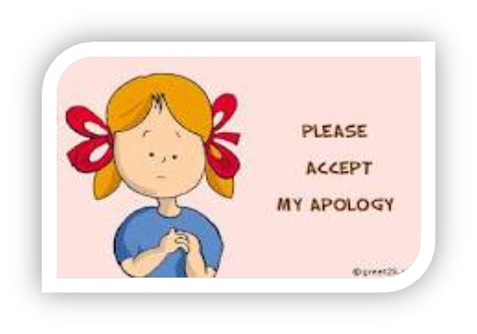
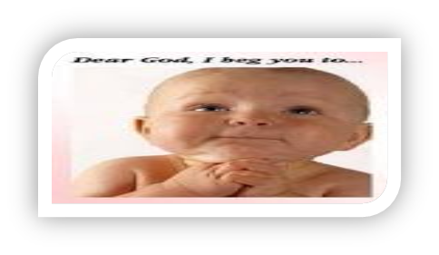
EXAMPLES:
I admit I can’t see as well as I used to.
We apologies for not replying earlier.
I must beg you to keep this a secret.

